Slide 1

Home price estimator project using python
Nick Miller - Bellevue University – Summer 2020

Slide 2
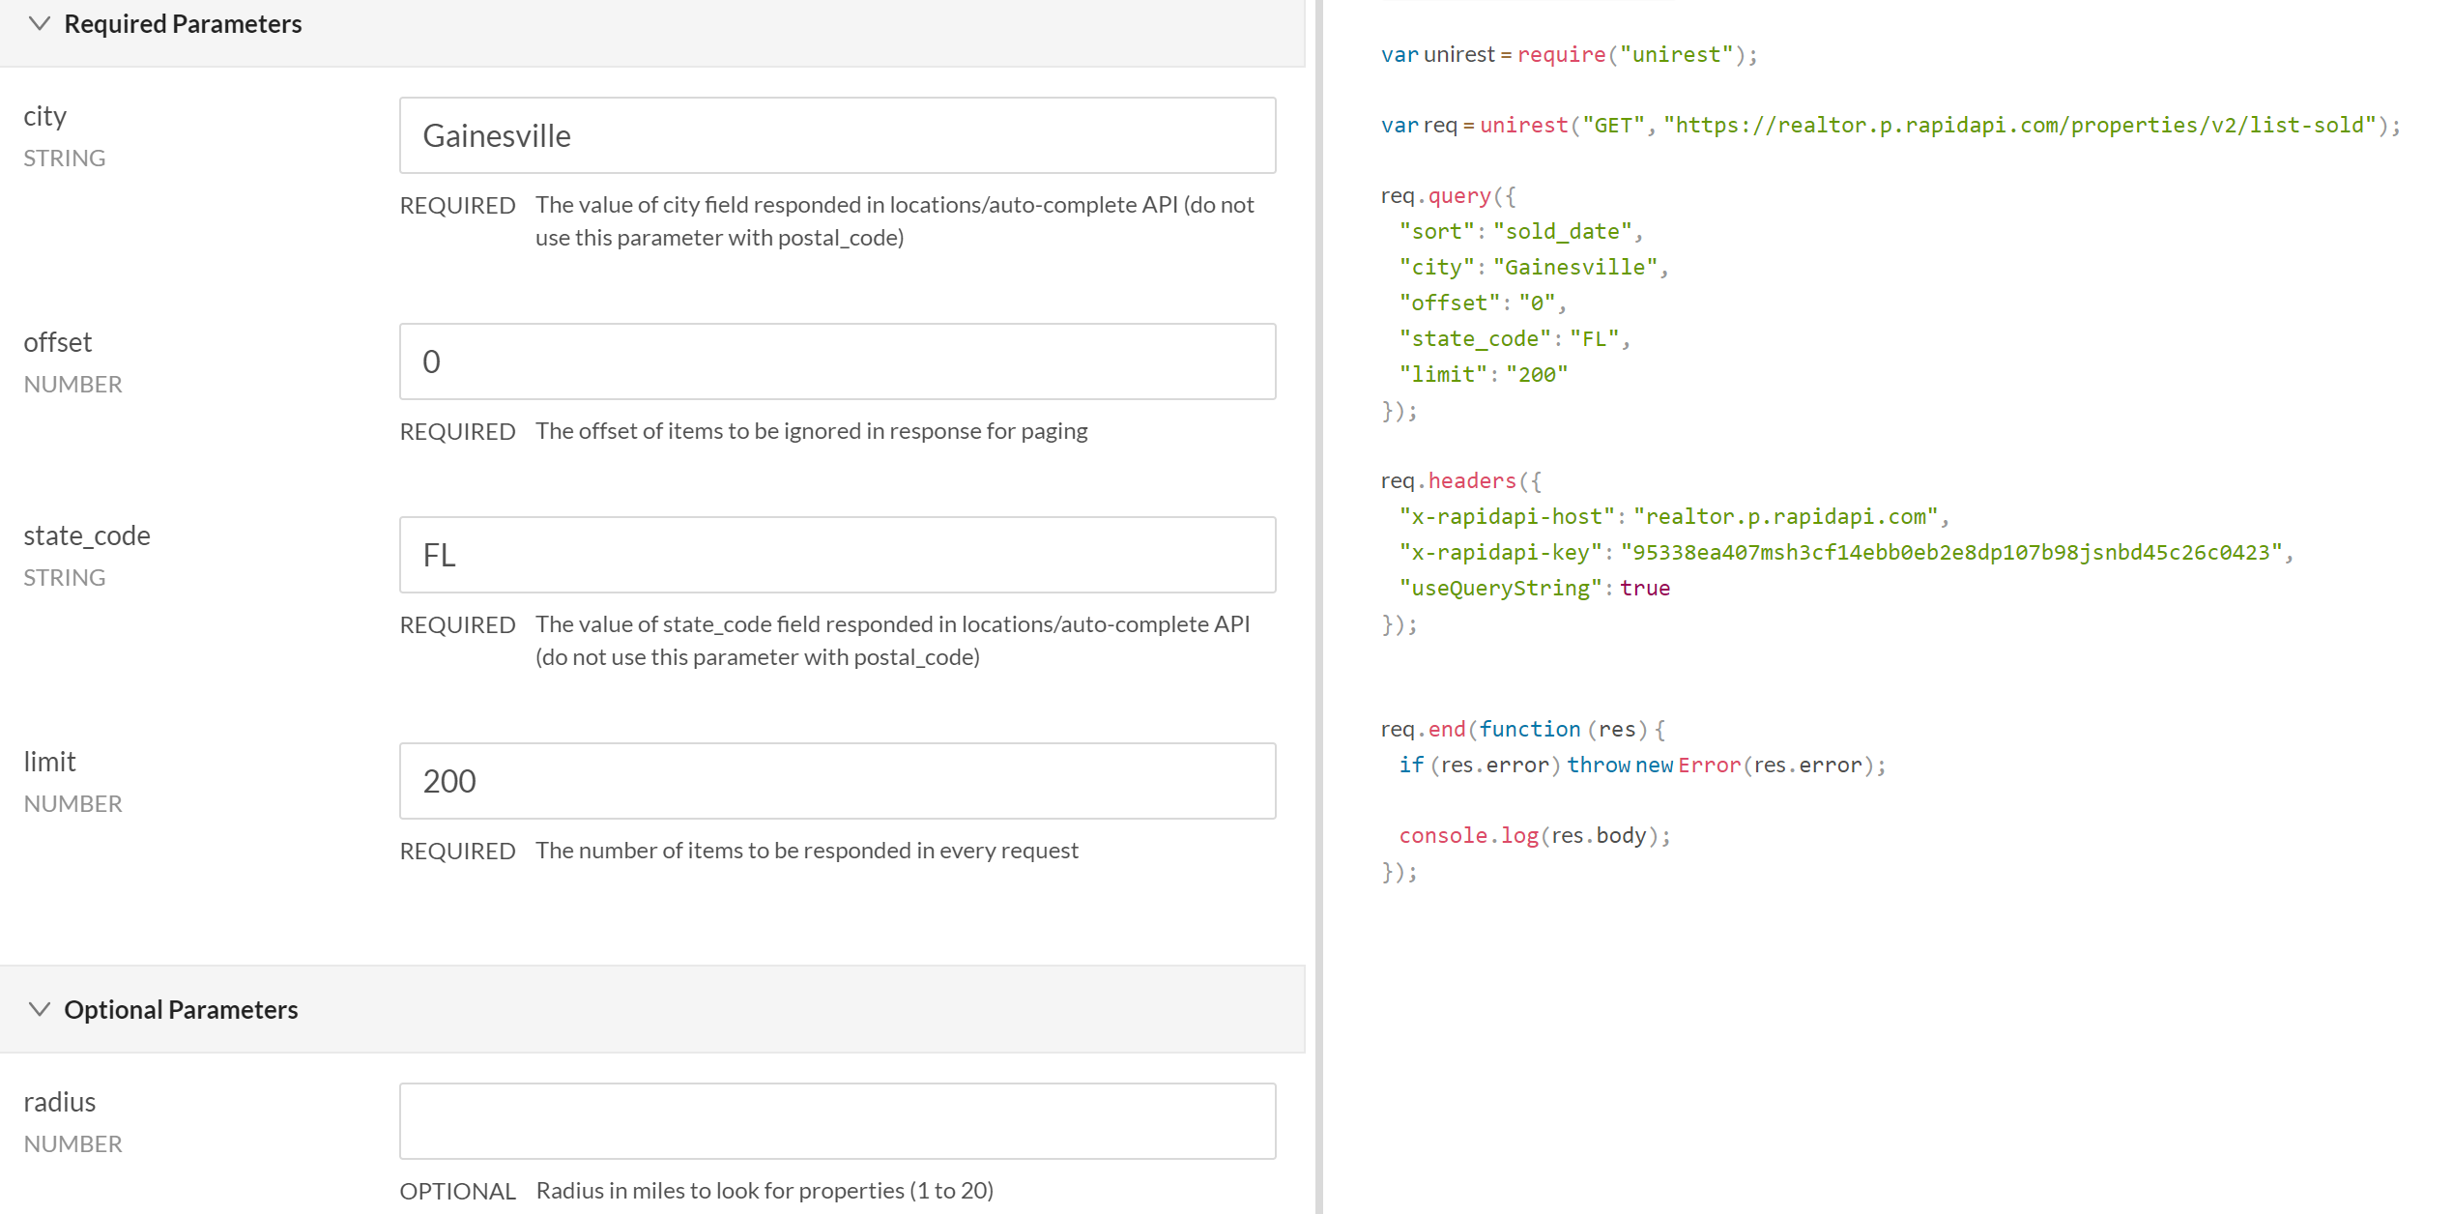
Realtor.com API

Slide 3
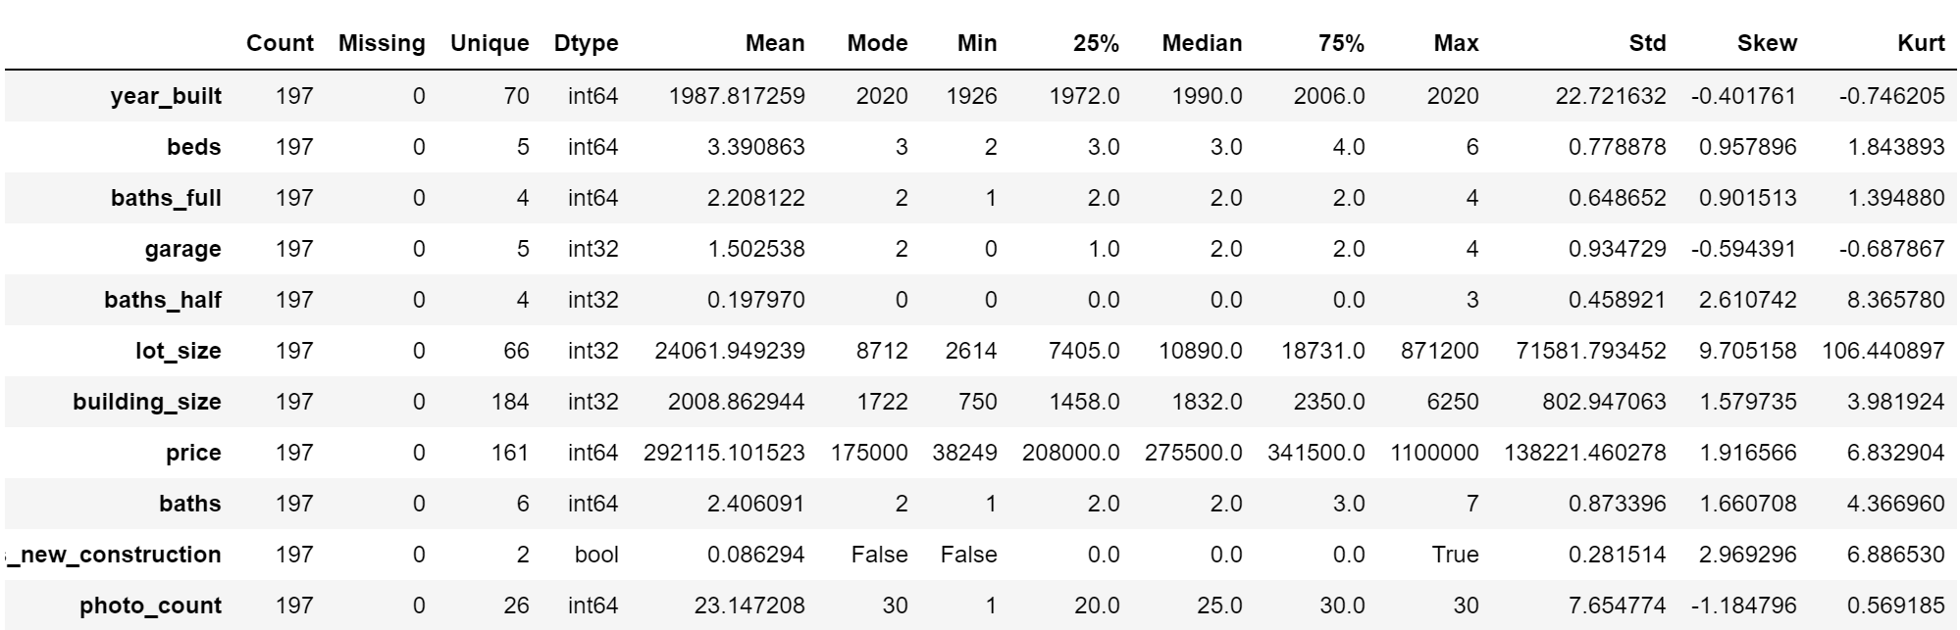
Univariate analysis

Slide 4
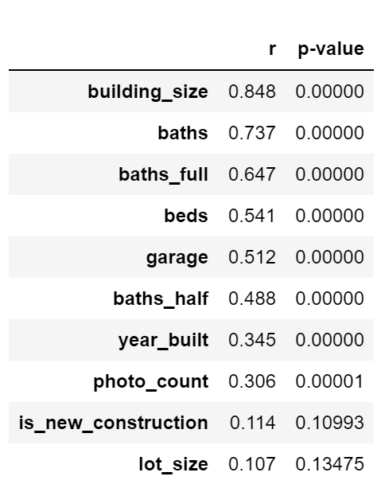
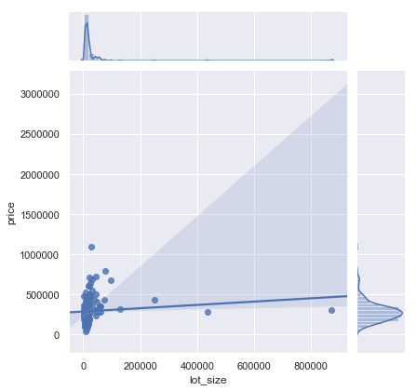
Bivariate analysis

Slide 5
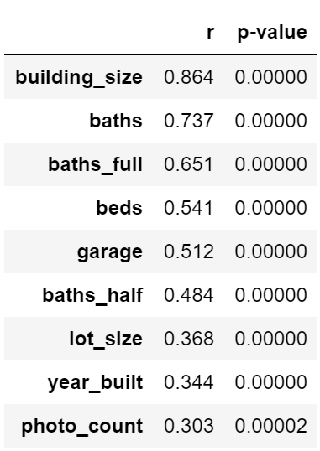
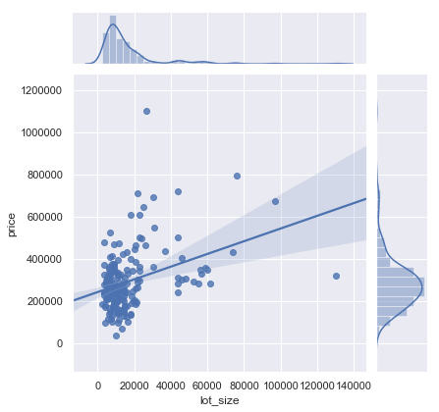
Outliers removed

Slide 6
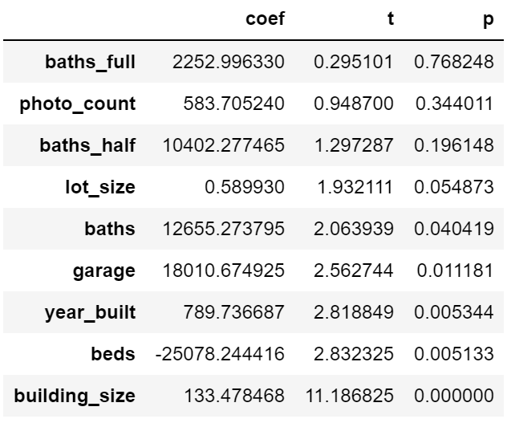
Multivariate analysis

Slide 7
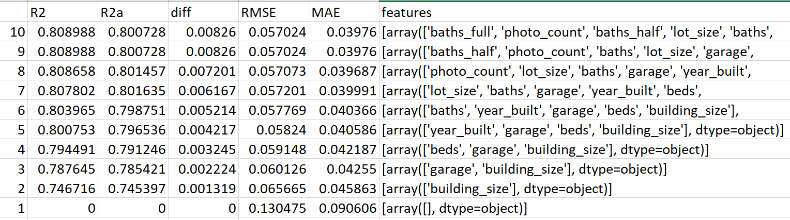
Machine learning

Slide 8
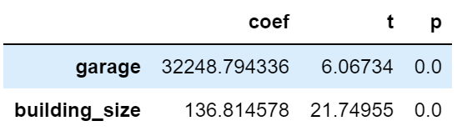
Reduce variables

Slide 9
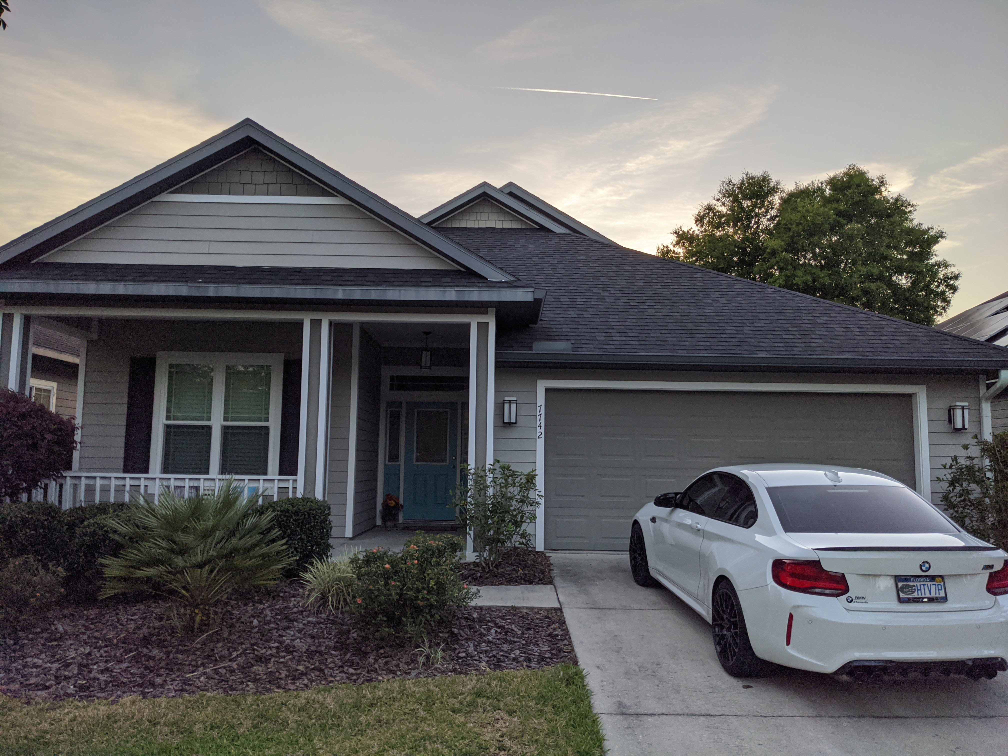
conclusion
2-car garage, 1600 square feet, the price would be 2*32249 + 1600*137 = $283698

